Slide 1

May 23 Videoconference
Arnie Schneider
Alan Flury
Scheller College of Business

Slide 2
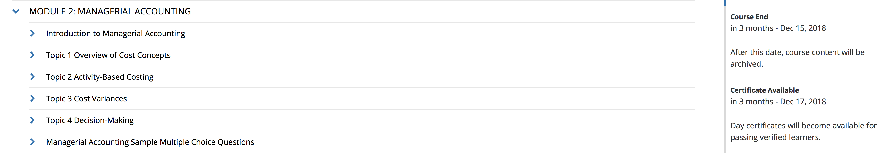
MGT8803 Business Fundamentals for Analytics Video Conference Call #3 Announcements
Financial Accounting Homework is due on Wednesday May 29 at 11:59pm eastern daylight time. Remember you can use outside resources and can collaborate with other students but cannot share actual answers. Any related posts that contain your work should be private. Homework questions cannot be discussed on the call tonight
This week to keep on pace you will need to compete the homework and work on the following topics by the next Videoconference

Slide 3
MGT8803 Business Fundamentals for Analytics Video Conference Call #3 Financial Accounting Topics 3 and 4
Questions, Discussion, Problems:
Non-Current Assets and Liabilities
Stockholders Equity and Ratio Analysis
Class Exercise: Constructing Financial Statements

Slide 4
MGT8803 Business Fundamentals for Analytics Video Conference Call #3 Questions and Discussion Items (From the Forum)
Please explain again what Discounts on Bonds Payable are and how they should be shown on the Balance Sheet. Also explain how a Premium on Bonds Payable is treated. What does “carrying value” mean?
In order to calculate the total of liabilities, are we meant to add the "Current Portion" to the aggregated one? For example, for "Current Portion of Bonds Payable" and "Bonds Payable", are we meant to add them up or do we just take "Bonds Payable"?
Some confusion about the treatment of dividends declared vs dividends paid and the impact on retained earnings.
The Capital Stock video (first video in Module 1 Topic 4) mentions that treasury stock is recorded as a contra-equity account and that no gain or loss is recorded if that treasury stock is re-issued at a later date. Does this mean that treasury stock must be re-issued at the same price for which it was re-purchased, resulting in no gain/loss? Or is it sold at the current market price and the gain/loss goes straight into something like retained earnings to balance the inflow of cash on the asset side of the balance sheet? After all, you would have to record the cash from the treasury stock sale, so that gain/loss needs to balance somewhere on the liability/equity side of the balance sheet right. I feel like the latter situation makes more sense, but the video clearly says no gain or loss is recorded so I'm confused about what would happen here.

Slide 5
MGT8803 Business Fundamentals for Analytics Video Conference Call #3 Questions and Discussion Items (From the Forum)
When we see a question that list common stock, should be assume that the account combines the “Paid-In Capital” and the Par Value” into a single account. Are companies required to report the two separately as separate line items on the balance sheet?
If a company develops software for it's own internal use (not for resale), and uses that software as part of services that it provides, does the company have to wait for technological feasibility until it capitalizes the cost incurred to develop the software? Is that software considered an intangible asset and amortized over a period of time, or is the software continuously evaluated for impairment? I am curious because I know of many companies that continue to expand and refine their internal software systems for many many years. (Well over 20, in the case of some large health insurance companies.)
Is it typical that the most recent columns in a financial sheet that uses successive years places the most recent year in the left most column. e.g. 2019 2018 2017 2016
Is Market Capitalization (# shares * price of share) same as Paid-In Capital (= Par Value of Common Stock + Paid-In Capital In Excess of Par)?

Slide 6
MGT8803 Business Fundamentals for Analytics Video Conference Call #3 Gain or Loss on Retirement of Bonds
Cann Corp. issued bonds with a face value of $100,000 and a stated interest rate of 8%. Cann Corp. retired these bonds for $125,000 before the maturity date. At the time, the bonds had a carrying value of $118,000. Determine the amount of gain or loss on the bond retirement.
Loss on Retirement of Bonds = $125,000 - $118,000 = $7,000 (loss)
Related Question. Why would the company pay $125,000 to retire bonds that only have a face value of $100,000

Slide 7
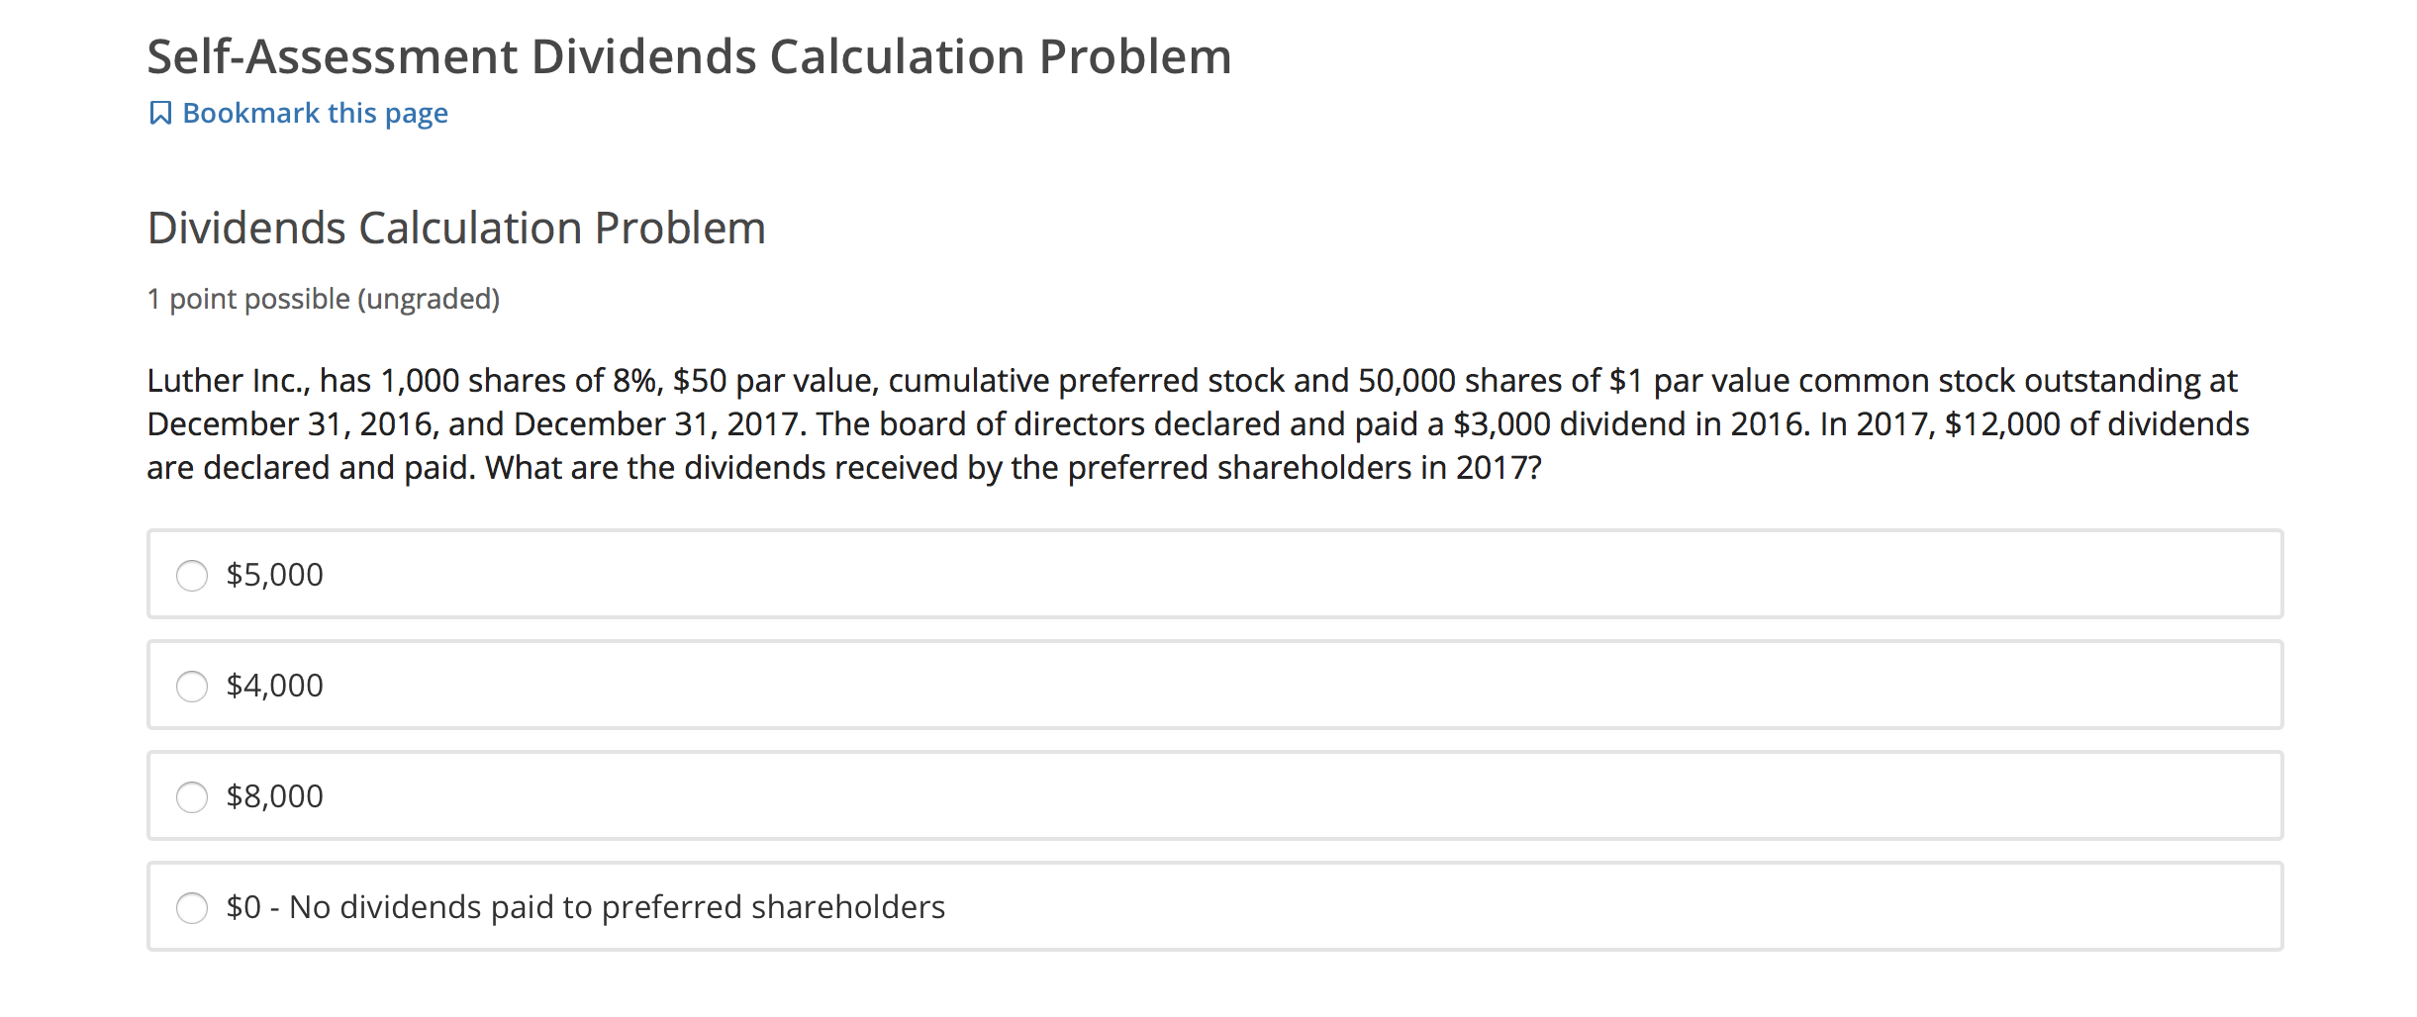
MGT8803 Business Fundamentals for Analytics Video Conference Call #3 Dividends
Year Scheduled Actual Arrears
2016 $4000* $3000 $1000
2017 $4000 $5000 $0
Preferred dividend payment = ($50 * 1000) * .08 = $4000/year
NOTE that the common share holders will be paid $0 dividends in 2016 and $7000 in 2017.

Slide 8
MGT8803 Business Fundamentals for Analytics Video Conference Call #3 Retained Earnings Problem
At the end of fiscal year 2017 ClownCar Products had the following account balances on their firms Balance Sheet:
Common Stock $45,550,500
Treasury Stock $(2,750,000)
Retained Earnings $18,950,000
Total Owners Equity $61,750,500
During FY2018 the firm had Net Earnings (after tax) of $3,200,150; declared $2,000,000 in shareholder dividends, and repurchased 250,000 shares of their outstanding stock $11.20/share*. No new shares of stock were issued.
What are the ending balances for ClownCar’s equity section for FY ending 2018
Beginning 2017 Activity Ending
Common Stock $45,550,500 $45,550,500
Treasury Stock $(2,750,000) ($2,800,000) $(5,550,000)
Retained Earnings $18,950,000
Net Income +$3,200,150
Dividends Declared ($2,000,000) $20,150,150
Total Owners Equity $61,750,500 $60,150,650
* 250,000*$11.20 = $2.8million

Slide 9
MGT8803 Business Fundamentals for Analytics Video Conference Call #3 Financial Accounting Class Exercise
Account Type Statement
Cash Asset BS*
Deferred Revenue Liability BS*
Treasury Stock Contra-Equity BS
Cost of Goods Sold Expense IS
Interest Expense Expense IS
Interest Payable Liability BS*
Sales Revenues IS
Sales Discounts Contra-Revenue IS
Sales Returns Contra-Revenue IS
Discounts on Bonds Payable Contra-Liability BS
Premium on Bonds Payable Liability BS
Inventory Asset BS*
Wages Payable Liability BS*
Common Stock at Par Value Equity BS
Accumulated Depreciation Contra-Asset BS
*current

Slide 10
MGT8803 Business Fundamentals for Analytics Video Conference Call #3 Financial Accounting Class Exercise
Account Type Statement
Taxes Payable Liability BS*
Pre-Paid Expense Asset BS*
Dividends Payable Liability BS*
Depreciation Expense Expense IS
Short Term Marketable Securities Asset BS*
Allowance for Uncollectable Receivables Contra-Asset BS*
Bad Debt Expense Expense IS
Utilities Expense Expense IS
Rent Expense Expense IS
Bonds Payable Liability BS
Current Portion of Bonds Payable Liability BS*
Current Portion of Mortgage Payable Liability BS*
Mortgage Payable Liability BS
Retained Earnings Equity BS
Salaries Expense Expense IS
Salaries Payable Liability BS*
Common Stock Paid in Capital Equity BS
*current

Slide 11
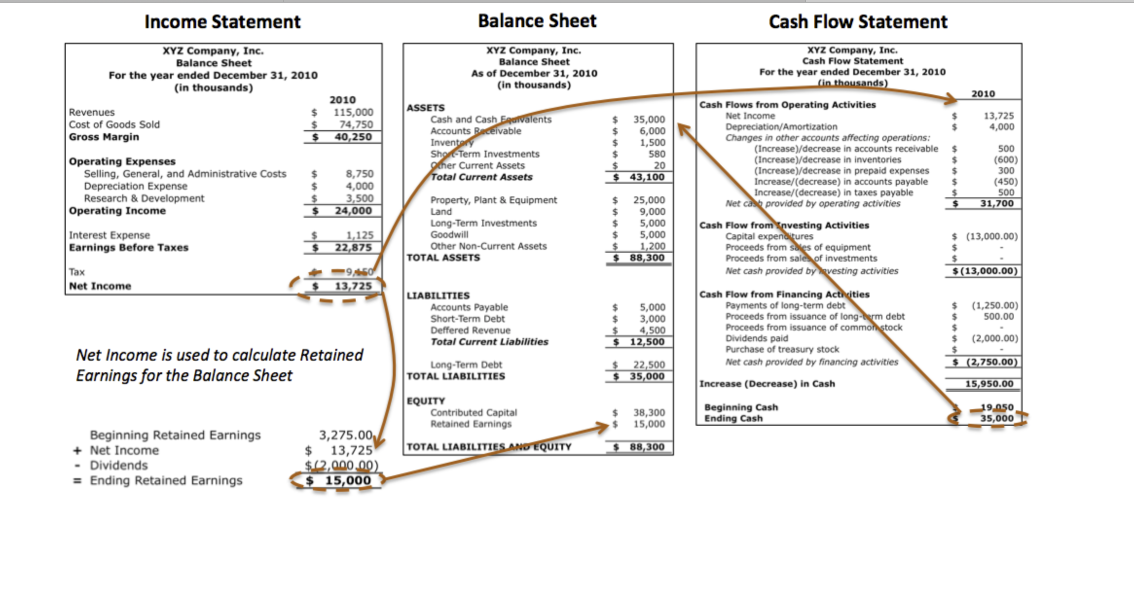
MGT8803 Business Fundamentals for Analytics Video Conference Call #3 Structural Relationships Between Financial Statements

Slide 12
MGT8803 Business Fundamentals for Analytics Video Conference Call #3 Mike’s Soft Drinks Sample Problem
Cash $8,488 Accounts Payable $5,200
Ending Inventory $8,374 Bonds Payable $2,150
Inventory Purchases (Net) $19,222 Common Stock $9,500
Sales Discounts $1,100 Cost of Goods Sold ???
Buildings and Equipment $12,500 Land $6,000
Bad Debt Expense $75 Dividends Declared $1,800
Beginning Inventory $7,225 Mortgage Payable $4,700
Retained Earning (Ending) ??? Retained Earning at Beginning of Period $12,200
Rent and Utilities $770 Premium on Bonds Payable $175
Accounts Receivable $7,199 Treasury Stock $750
Sales $29,555 Accumulated Depreciation $3,750
Allowance for Doubtful Accounts $800 Dividends Payable $1,800
Depreciation Expense $725 Interest Expense $130
Short Term Marketable Securities $320 Income Tax Expense $1,448
Wages Payable $22 Wages Expense $2,100
Indicated above is accounting information for Mike’s Soft Drinks as of the period ending December 31, 2018. All information shown is in $000. Using the information shown above please develop a Balance Sheet and Income Statement for the period ending December 31, 2018.

Slide 13
MGT8803 Business Fundamentals for Analytics Video Conference Call #3 Mike’s Soft Drinks Income Statement
Sales $29,555
Sales Discounts (1,100)
Less Cost of Goods Sold (18,073)
Gross Margin $10,382
Less: Operating Expenses
Wages Expense $2,100
Rent and Utilities 770
Bad Debt Expense 75
Depreciation Expense 725
Total Operating Expenses $3,670
EBIT $6,712
Interest Expense 130
Income Tax Expense 1,448
Net Income $5,134
Cost of Good Sold Calculation
Beginning Finished Goods Inventory $7,225
Plus Cost of Goods Purchased for Resale 19,222
Less Ending Finished Goods Inventory (8,374)
Cost of Goods Sold $18,073
Retained Earning Calculation:
Beginning RE $12,200
Plus NI 5,134
Less Dividends Declared (1,800)
Ending RE $15,534

Slide 14
MGT6754 Business Fundamentals for Analytics Video Conference Call #3 Mike’s Soft Drinks – Balance Sheet
Cash $8,488
Short Term Marketable Securities 320
Accounts Receivable (Net of $800). 6,399
Inventory 8,374
Total Current Assets $23,581
Building and Equipment $12,500 Less Accumulated Depreciation (3,750)
Land 6,000
Total Assets $38,331
Accounts Payable $5,200
Wages Payable 22
Dividends Payable 1,800
Total Current Liabilities $7,022
Bonds Payable $2,150
Premium on Bonds Payable 175
Mortgage Payable 4,700
Total Liabilities $14,047
Owners Equity:
Capital Stock $9,500
Treasury Stock (750)
Retained Earnings 15,534
Total Owners Equity $24,284
Total Liabilities and Owners Equity $38,331

Slide 15
MGT6754 Business Fundamentals for Analytics Video Conference Call #3 Mike’s Soft Drinks – Key Ratios
Current ratio:
Total current assets $23,581
Total current liabilities $7,022
= 3.36
Debt ratio:
Total liabilities $14,047
Total assets $38,331
= .37
Profit margin ratio:
Net income $5,134
Net Sales $28,455
= .18 or 18%

